Slide 1



ASP.NET Filters
ASP.NET MVC
Introduction
SoftUni Team
Technical Trainers
Software University
http://softuni.bg

Slide 2
Have a Question?
sli.do #CSharpWeb

Slide 3
Types of Filters
The ASP.NET MVC framework supports four different types of filters:
Authorization Filters: Implements the IAuthorizationFilter attribute.
Action Filters: Implements the IActionFilter attribute.
Result Filters: Implements the IResultFilter attribute.
Exception Filters: Implements the IExceptionFilter attribute.
Notes:
Filters are executed in the order listed above. For example, authorization filters are always executed before action filters and exception filters are always executed after every other type of filter.

Slide 4
Action Filters
Apply pre- and post-processing logic
Can be applied to actions and to controllers
Global filters can be registered in GlobalFilters.
Filters (or in /App_Start/FilterConfig.cs)
Name | Description
OutputCache | Cache the output of a controller
Authorize | Restrict an action to authorized users or roles
ValidateAntiForgeryToken | Helps prevent cross site request forgeries
HandleError | Can specify a view to render in the event of an unhandled exception

Slide 5
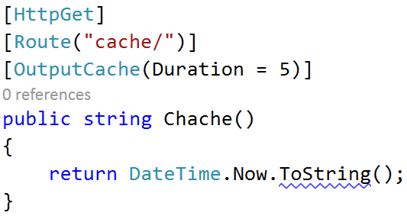
Output cache
Output cache caches the output of an action for a given period of time.
In this case the Chache action will be cached for 5 seconds.

Slide 6
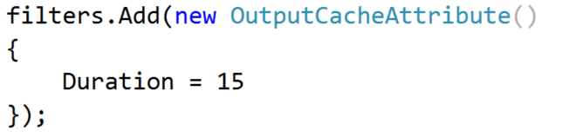
Output cache (2)
Another option to apply caching in the whole application is to register an OutputCacheFilter in the FilterConfig and setting it’s duration there.

Slide 7

Handle Error
Handle Error give us the ability to show a different view depending on the action and the exception it throws. The default HandleErrorAttribute is registered in the FilterConfig and it searches for a view called Error.

Slide 8

Handle Error
In order to allow the usage of user friendly error views, you must enable them. To do so, go the web config and write the following:
When the mode is “On”, everybody will see the friendly errors.
When it is “RemoteOnly” people from the localhost we see the more developer friendly exception.

Slide 9
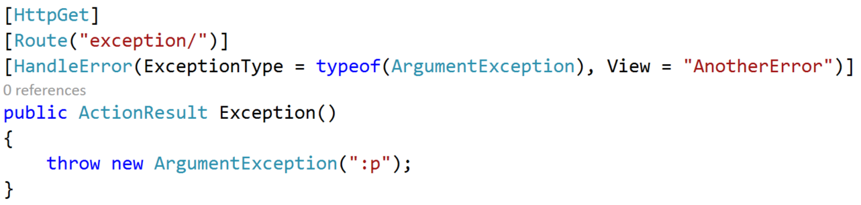
Handle Error (2)
We can easily configure this, by attaching a HandleError attribute to an action.

Slide 10
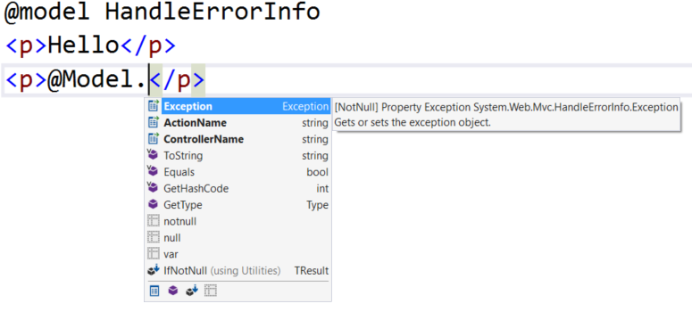
Handle Error (3)
If we want to take information about the exception, we should receive a HandleErrorInfo model in the View(“AnotherError”)

Slide 11

Custom Action Filter
Create a C# class file in /Filters/
Inherit ActionFilterAttribute
We can override the following methods:
OnActionExecuting(ActionExecutingContext)
OnActionExecuted(ActionExecutedContext)
OnResultExecuting(ResultExecutingContext)
OnResultExecuted(ResultExecutedContext)
We can apply our new attribute to a controller, method or globally in GlobalFilters.Filters

Slide 12
Custom Action Filter (2)
public class LogAttribute : ActionFilterAttribute
{
public override void OnActionExecuting(ActionExecutingContext filterContext)
{ … }
public override void OnActionExecuted(ActionExecutedContext filterContext)
{ … }
public override void OnResultExecuting(ResultExecutingContext filterContext)
{ … }
public override void OnResultExecuted(ResultExecutedContext filterContext)
{ … }
}
[Log]
public class DepartmentController : Controller { … }

Slide 13








ASP.NET Filters
https://softuni.bg/courses/

Slide 14
License
This course (slides, examples, demos, videos, homework, etc.) is licensed under the "Creative Commons Attribution-NonCommercial-ShareAlike 4.0 International" license

Slide 15






Free Trainings @ Software University
Software University Foundation – softuni.org
Software University – High-Quality Education, Profession and Job for Software Developers
softuni.bg
Software University @ Facebook
facebook.com/SoftwareUniversity
Software University @ YouTube
youtube.com/SoftwareUniversity
Software University Forums – forum.softuni.bg

